Slide 1
ELEC 694
COMP 694
Topics Not Chosen
Scott Cutler
cutler@rice.edu
4/10/2013

Slide 2
Current Roster
Ryan Artecona
Rob Bauer
Enoch Chang
Jianbo Chen
Ahmed Haque
Zhiyong Tan

Slide 3
Last Week’s Events of the Week
Microsoft, Google swap April Fools' barbs
T-Mobile finally gets the iPhone, T-Mobile launches 4G LTE network
T-Mobile USA kills traditional cell contracts in subscriber boost bid
Dell Drama Takes New Twist with 2 New Buyout Bids
With Windows Blue comes fear of desktop's demise
New Windows 8 hardware specs hint at 7-inch tablets and a Microsoft Reader
Apple envisions future iPhone with wrap-around display
Apple's mea culpa works wonders in China
Apple Buys Indoor Mapping Startup for $20 Million
USPTO reaffirms invalidation of Apple patent in Samsung suit
Microsoft drops its patent list online
Meet the Man Who Sold His Fate to Investors at $1 a Share
Android outscores iOS in U.S. smartphone sales, says report
Google Street View Unveils Images of Japan's Nuke Evacuation Area
Facebook event may reveal deeper Android integration
Amazon S3 Users Exposing Data to Public

Slide 4
Schedule for Spring 2013
01/09/13 Introduction and Accelerating Technology(Cutler)
01/16/13 Disruptive Technologies (Cutler)
01/23/13 Creating and Delivering Great Presentations (Volz)
01/30/13 Consumer Medical Electronics (Ahmed Haque)
02/06/13 Identity Theft / Phishing (Enoch Chang)
02/13/13 Internet of Things (Ryan Artecona)
02/20/13 No Class – family emergency
02/27/13 No Class - Rice midterm recess
03/06/13 Storage (Jianbo Chen)
03/13/13 No Class – family emergency
03/20/13 HTML 5 (Zhiyong Tan)
03/27/13 Ecosystem Group Discussion (All)
04/03/13 Internet Video (Rob Bauer)
04/10/13 Topics Not Chosen (Cutler) - Prep for Final Projects (All)
04/17/13 Final Projects - Final Papers Due (All)
04/21/13? Possible Optional Off-site (a.k.a. end of semester party)

Slide 5
Preparation Schedule
Date | Class | Topic# | Topic Name | Presenter | Preparation Meetings
 |  |  |  |  | Volz | Final Draft | 2nd Draft | 1st Draft | Outline | Initial
12/26/2012 |  |  |  |  |  |  |  |  |  | Haque
1/2/2013 |  |  |  |  |  |  |  |  | Haque | Chang
1/9/2013 | 1 |  | Introduction and Technology Acceleration | Cutler |  |  |  | Haque | Chang | Artecona
1/16/2013 | 2 |  | Disruptive Technologies | Cutler |  |  | Haque | Chang | Artecona | Chen
1/23/2013 | 3 |  | Creating and Giving Great Presentations | Volz | Haque | Haque | Chang | Artecona | Chen | Tan
1/30/2013 | 4 | 1 | Consumer Medical Devices | Haque | Chang | Chang | Artecona | Chen | Tan | Bauer
2/6/2013 | 5 | 2 | Identity Theft / Phishing | Chang | Artecona | Artecona | Chen | Tan | Bauer
2/13/2013 | 6 | 3 | Internet of Things | Artecona | Chen | Chen | Tan | Bauer
2/20/2013
2/27/2013
3/6/2013 | 7 | 4 | Storage | Chen | Tan | Tan | Bauer
3/13/2013
3/20/2013 | 8 | 5 | HTML 5 | Tan | Bauer | Bauer
3/27/2013 | 9 |  | Group Ecosystem Discussion | All
4/3/2013 | 10 | 6 | Internet Video | Bauer
4/10/2013 | 11 |  | Topics Not Chosen / Prep for Group Projects | Cutler / All
4/17/2013 | 12 |  | Final Group Projects | All
4/21/2013 |  |  | Tentative date for Off-Site (Optional)

Slide 6
Next Week’s Mini-Discussion
Some weeks, we will have a short group discussion on a topic rather than Events of the Week.
Purpose is an exercise in thinking beyond the top level issues of a topic.
I expect roughly 30 minutes of research and thought
Our final mini-discussion is this week. Next week we have:
Events of the Week
Presented by All

Slide 7
Final Paper
Everyone has to submit a paper on any of the topic from the list
  99% chose same topic as presentation!
Roughly 20 pages; but can be more or less
Covers same material as presentations with a stronger emphasis on the future and what other technologies impact or are impacted by chosen topic.
Submit electronically – save trees
Can be started and submitted at ANY time
  Due April 17

Slide 8
Final Projects
At the April 3rd class, you will be assigned to one of two teams.
You will be given a topic covering a technology with a 10 year horizon.
The April 10th class will start with a discussion on Topics Not Chosen (I will present) followed by prep time for final project.
April 17th class will consist of two 15-20 minute group presentations on final topic.

Slide 9
Final Projects
Topic:
  Automobile Electronics in the year 2020
Team A
  Ahmed Haque
  Ryan Artecona
  Zhiyong Tan
Team B
  Enoch Chang
  Jianbo Chen
  Rob Bauer

Slide 10
Seminar #12
Final projects– Teams A and B
  Logistics
    Wednesday, April 17, 9:30 – 11:00, DH-2014
Mini-Discussion – Final Events of the Week
One-on-One meetings:
  None !

Slide 11
Topics Not Chosen
Scott Cutler
4/10/2013

Slide 12
Candidate Topics – Spring 2013
  Advanced Computer Inputs – Kinect, Touch Screens
  ARM vs. x86 for mainstream usage and/or Intel vs. NVIDIA
  Automotive Electronics beyond the engine including GPS, XM audio, XM data, cellular data
  Cloud Computing
  Consumer Medical Devices / Electronic Medical Records (consumer)
  Digital Living Room - AirPlay and dLNA, networked receivers
  HTML 5
  Identity theft / phishing
  Intellectual Property, patent trolls, law suits, DRM for movies / TV ad revenue model
  Internet of things, Embedded cellular data modems, Ultra low powered computing
  Internet Video / Netflix / Google TV, Apple TV, repurposed game machines
  Main Stream Processors and Chipsets / Parallel, multi-core technology for consumer uses
  NFC and Mobile Payments
  Shared Metered 4G LTE Data Plans
  Social Media – specifically Facebook long term or quick rise/fall or Twitter business model
  Storage – SATA, Solid State Drives, Flash, RAID, Backup, disk in the clouds
  Voice Recognition Assistants
  Windows 8 / 8RT

Slide 13
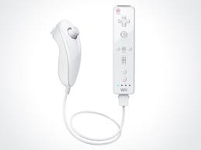

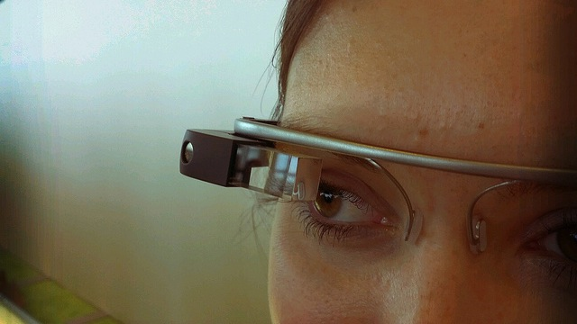

Advanced Computer Inputs

Slide 14

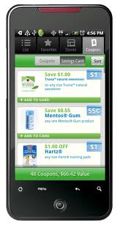

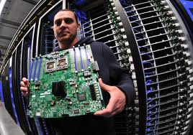
ARM vs. x86 for mainstream usage and/or Intel vs. NVIDIA

Slide 15
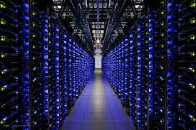



Cloud Computing

Slide 16
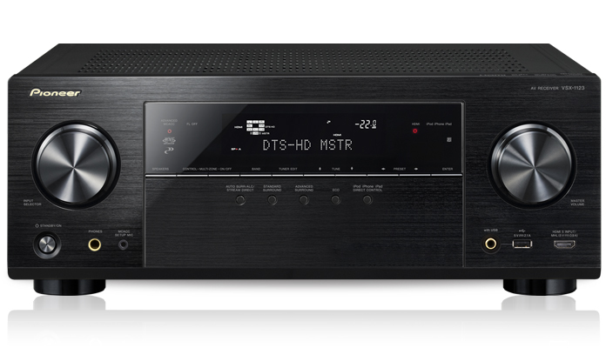
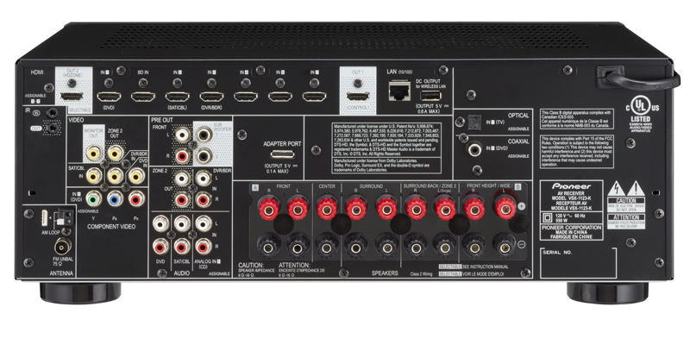
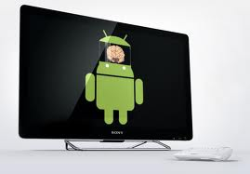
  Digital Living Room - AirPlay and dLNA, networked receivers
VSX-1123-K
WiFi Ready with AirPlay, dLNA, HTC Connect & Pandora Music Streaming
7.2 Channels with Advanced Audio & 1080p Video Processing
FREE Advanced Remote Control App for Apple & Select Android Devices, "iControlAV2012“
Ultra HD (4K) Upscaling and Pass-Through

Slide 17
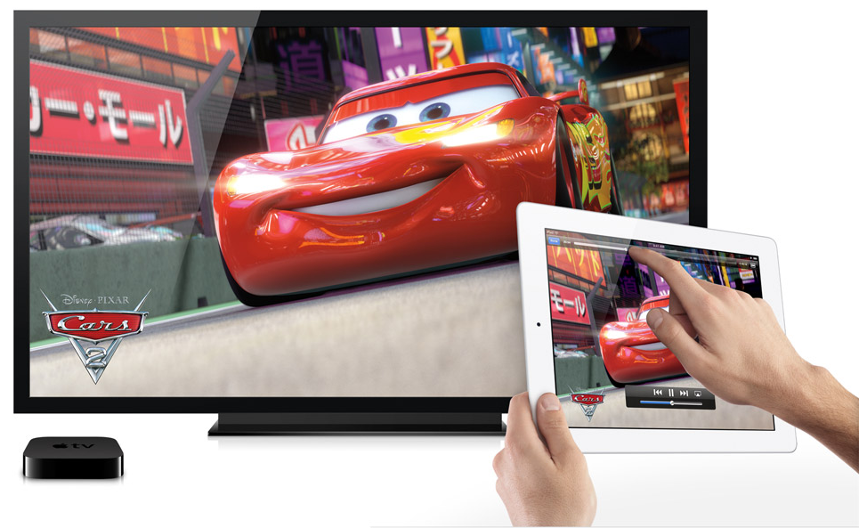
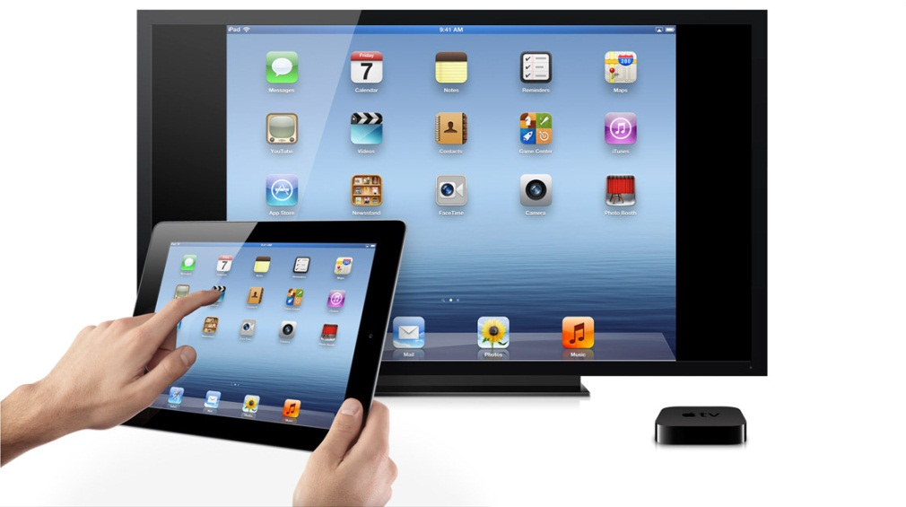
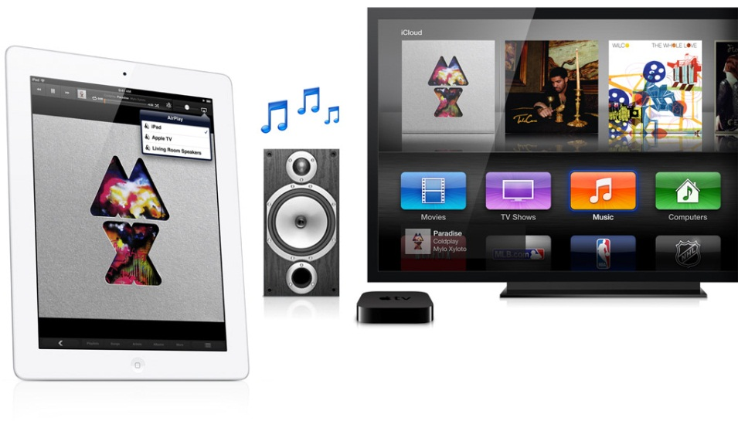

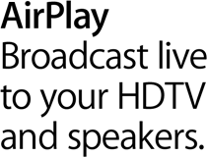
  Digital Living Room - AirPlay and dLNA, networked receivers - 2

Slide 18
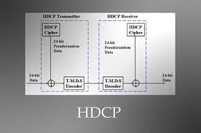






Intellectual Property, patent trolls, law suits, DRM for movies / TV ad revenue model

Slide 19
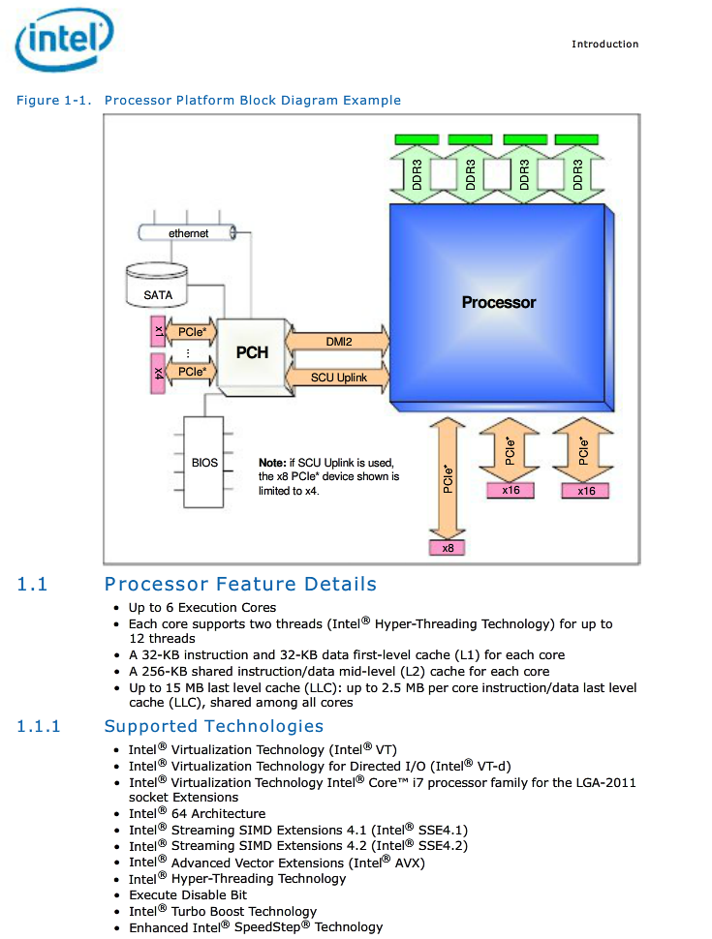
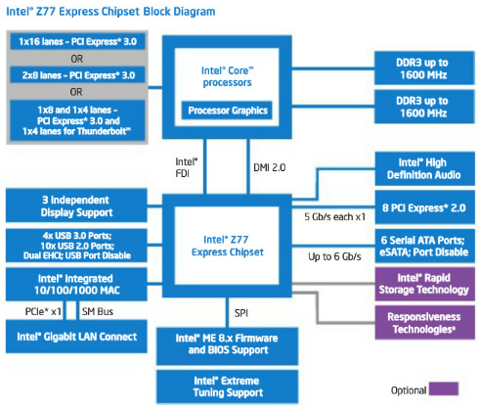
Main Stream Processors and Chipsets
  64 bit computing
  Parallel, multi-core technology for consumer uses

Slide 20
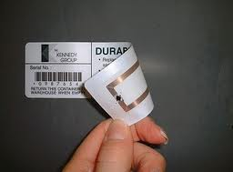
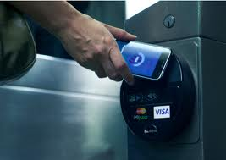
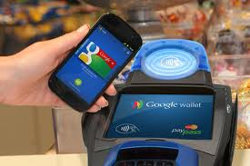
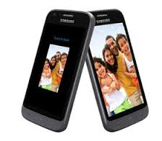
NFC and Mobile Payments

Slide 21
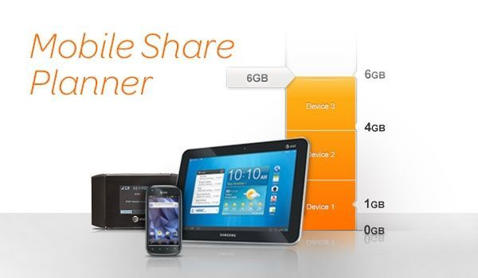

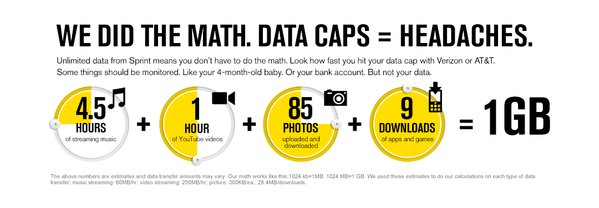
Shared Metered 4G LTE Data Plans

Slide 22





  Social Media – specifically Facebook long term or quick rise/fall or Twitter business model

Slide 23




Voice Recognition Assistants

Slide 24



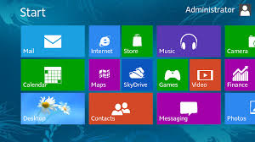
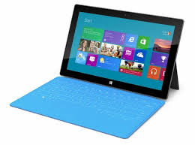
Windows 8 / 8RT

Slide 25
Automotive Electronics
  I would not want to spoil all of your fun!

Slide 26
So Many Technologies
Life is good!

