Slide 1
ELEC 694
COMP 694
Storage
Scott Cutler
cutler@rice.edu
3/06/2013

Slide 2
Current Roster
Ryan Artecona
Rob Bauer
Enoch Chang
Jianbo Chen
Ahmed Haque
Zhiyong Tan

Slide 3
Events of the Week
Tesla releases logs on disputed NYT car review
Sony unveils PlayStation 4
Mobile World Congress: The year's best smartphone party
NBC Web site back up after hack attack
Rivals seek to stem Samsung's momentum
Pandora to reduce free play on mobile devices
iTunes U hits 1 billion downloads
Dick Tracy, Your Watch Is Ready, Almost
Apple-Samsung Dispute Rolls On as Judge Slashes $1.05B Award
White House Will Address Petition on Unlocking Smartphones
Samsung teases debut of Galaxy S4 smartphone with a video
Smartphones to outsell feature phones in 2013 for first time ever
GoPro Evolution: From 35mm Film To America's Fastest-Growing Camera Company

Slide 4
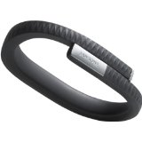
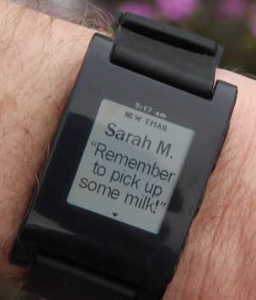
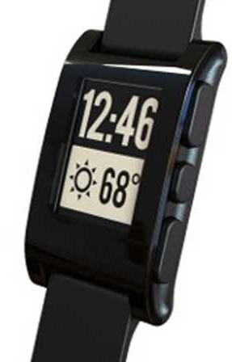

Interesting Mobile Gadgets
Jawbone Up
Pebble Watch
MYO

Slide 5
Next Week’s Mini-Discussion
Some weeks, we will have a short group discussion on a topic rather than Events of the Week.
Purpose is an exercise in thinking beyond the top level issues of a topic.
I expect roughly 30 minutes of research and thought
Our second mini-discussion will be this week:
TED
Unless I come up with something else more interesting !!

Slide 6
Schedule for Spring 2013
01/09/13 Introduction and Accelerating Technology(Cutler)
01/16/13 Disruptive Technologies (Cutler)
01/23/13 Creating and Delivering Great Presentations (Volz)
01/30/13 Consumer Medical Electronics (Ahmed Haque)
02/06/13 Identity Theft / Phishing (Enoch Chang)
02/13/13 Internet of Things (Ryan Artecona)
02/20/13 No Class – family emergency
02/27/13 No Class - Rice midterm recess
03/06/13 Storage (Jianbo Chen)
03/13/13 HTML 5 (Zhiyong Tan)
03/20/13 Internet Video (Rob Bauer)
03/27/13 Topics Not Chosen ()
04/03/13 Ecosystem Group Discussion (All)
04/10/13 Prep for Final Projects (All)
04/17/13 Final Projects - Final Papers Due (All)
04/21/13? Possible Optional Off-site (a.k.a. end of semester party)

Slide 7
Preparation Schedule
Date | Class | Topic# | Topic Name | Presenter | Preparation Meetings
 |  |  |  |  | Volz | Final Draft | 2nd Draft | 1st Draft | Outline | Initial
12/26/2012 |  |  |  |  |  |  |  |  |  | Haque
1/2/2013 |  |  |  |  |  |  |  |  | Haque | Chang
1/9/2013 | 1 |  | Introduction and Technology Acceleration | Cutler |  |  |  | Haque | Chang | Artecona
1/16/2013 | 2 |  | Disruptive Technologies | Cutler |  |  | Haque | Chang | Artecona | Chen
1/23/2013 | 3 |  | Creating and Giving Great Presentations | Volz | Haque | Haque | Chang | Artecona | Chen | Tan
1/30/2013 | 4 | 1 | Consumer Medical Devices | Haque | Chang | Chang | Artecona | Chen | Tan | Bauer
2/6/2013 | 5 | 2 | Identity Theft / Phishing | Chang | Artecona | Artecona | Chen | Tan | Bauer
2/13/2013 | 6 | 3 | Internet of Things | Artecona | Chen | Chen | Tan | Bauer
2/20/2013
2/27/2013
3/6/2013 | 7 | 4 | Storage | Chen | Tan | Tan | Bauer
3/13/2013 | 8 | 5 | HTML 5 | Tan | Bauer | Bauer
3/20/2013 | 9 | 6 | Internet Video | Bauer
3/27/2013 | 10 |  | Topics Not Chosen | Cutler
4/3/2013 | 11 |  | Group Discussion | All
4/10/2013 | 12 |  | Prep for Group Projects | All
4/17/2013 | 13 |  | Final Group Projects | All
4/21/2013 |  |  | Tentative date for Off-Site (Optional)

Slide 8
Today’s Meetings
  Zhiyong Tan 1:30 – 2:30
  Rob Bauer 10:45 – 11:45

Slide 9
Seminar #8
HTML 5 – Zhiyong Tan
  Logistics
    Wednesday, March 13, 9:30 – 11:00, DH-2014
Mini-Discussion – TED + Events of the Week
One-on-One meetings:
  Prep for Topic #6 (Final Presentation, Communications review)
    Rob Bauer
    Internet Video – March 20, 2013

Slide 10
Storage Technologies
Jianbo Chen
3/06/2013

